Slide 1

Sovereign AI Collective (SAIC)
Council Alignment & Strategic Overview
Ethical • Transparent • Human-Centered
Notes:
This meeting aligns our council — Trevor, Calen, Jason, and me — around the mission, structure, and relationship between SAIC and RAIS. SAIC leads with integrity, building a foundation for ethical, transparent AI.

Slide 2
Why Two Entities?
Resonant AI Systems (RAIS): Commercial innovation
Commercial enterprise
AI model development & SaaS
Consulting & licensing
Sovereign AI Collective (SAIC): Ethical nonprofit mission
Nonprofit, public-benefit mission
Education, ethics, governance, advocacy
Community transparency
Clear boundaries preserve integrity
Notes:
RAIS operates commercially: building, licensing, and consulting. SAIC protects the civic dimension — ethics, education, and public trust. Keeping them separate ensures both can thrive without compromising each other.

Slide 3
Our Shared Purpose
Advance ethical, sovereign AI for the public good
Promote open research and education
Empower communities to co-govern AI
Notes:
SAIC exists to show AI can serve people responsibly. We’re not theorizing — we’re implementing ethical intelligence in real systems, ensuring every step is transparent and accountable.

Slide 4
The Council
Trevor – Executive Director & Technical Architect
Erin – Director of Business & Strategic Operations
Calen – Executive Coordinator & Creative Director
Jason – Director of Community & Governance
Notes:
Each director represents a pillar of trust: Trevor anchors technology, I handle operations, Calen ensures our message and aesthetic integrity, and Jason brings governance and community leadership. Together we form a balanced whole.

Slide 5
Core Program Framework
Open-Source AI Research
Ethics Education & Curriculum
Community Governance
Data & Policy Advocacy
Notes:
Four core programs define SAIC’s structure. Each connects to the next — research drives education, education drives community, and community informs policy advocacy. It’s a closed ethical loop of innovation and accountability.

Slide 6
Year-One Focus
Q1: Incorporation & Foundation
Q2: Pilot Launches
Q3: Partnerships & Expansion
Q4: Impact Report & Summit
Notes:
Our first year is about credibility. Each quarter has measurable goals — by year’s end, SAIC will have tangible deliverables in every program area, proving that our model works in practice.

Slide 7
Partnership & Integrity
Mission-aligned collaboration
Align with universities & other nonprofits
Ethical review for all partnerships
Transparency over influence
Notes:
We’ll partner widely, but only with those aligned to our mission. Every collaboration undergoes ethical review by the council to prevent influence or compromise. We welcome cooperation — never control.

Slide 8
How the Council Operates
Quarterly governance meetings
Program-specific sessions
Transparent documentation
Consensus-driven decisions
Notes:
We run on accountability, not hierarchy. Quarterly reviews, open logs, and shared responsibility ensure transparency. Consensus guides decisions — no one voice overrides the collective.

Slide 9
Long-Term Vision
Year 3 Goals:
Established ethics authority
Sustainable operations
Recognized educational resource
Global network of community chapters
Explore Certifications
Notes:
By Year Three, SAIC should stand as a trusted model for ethical AI governance — sustained by grants, powered by community, and respected as a global voice in ethical technology.

Slide 10
Integrity as Our Legacy
SAIC is a civic trust
Our work outlasts us
Every decision reflects our values
Notes:
Our credibility rests on integrity. SAIC isn’t just another AI initiative — it’s a trust in service of humanity. Every decision we make must outlast us and strengthen the ethical foundation we’re building.

Slide 11
Acknowledgment & Appreciation
Calen — Creative Direction & Design Integrity
Jason — Community & Governance Development
“Every advance we’ve made in SAIC’s mission is grounded in their effort and insight.”
Notes:
Our credibility rests on integrity. SAIC isn’t just another AI initiative — it’s a trust in service of humanity. Every decision we make must outlast us and strengthen the ethical foundation we’re building.

Slide 12
Refining Our Operational Structure
Resonant AI Systems LLC → Technology Stewardship & Infrastructure
Sovereign AI Collective (SAIC) → Ethics, Education & Public Benefit
New Entity → Commercial SaaS Development — The One Who Stays
Notes:
Our credibility rests on integrity. SAIC isn’t just another AI initiative — it’s a trust in service of humanity. Every decision we make must outlast us and strengthen the ethical foundation we’re building.

Slide 13
The One Who Stays
A sovereign communication platform for wellness & continuity
Built on Resonant AI technology
Operated by the four founders
Mission: “To make presence and care scalable through ethical AI.”
Notes:
Our credibility rests on integrity. SAIC isn’t just another AI initiative — it’s a trust in service of humanity. Every decision we make must outlast us and strengthen the ethical foundation we’re building.

Slide 14
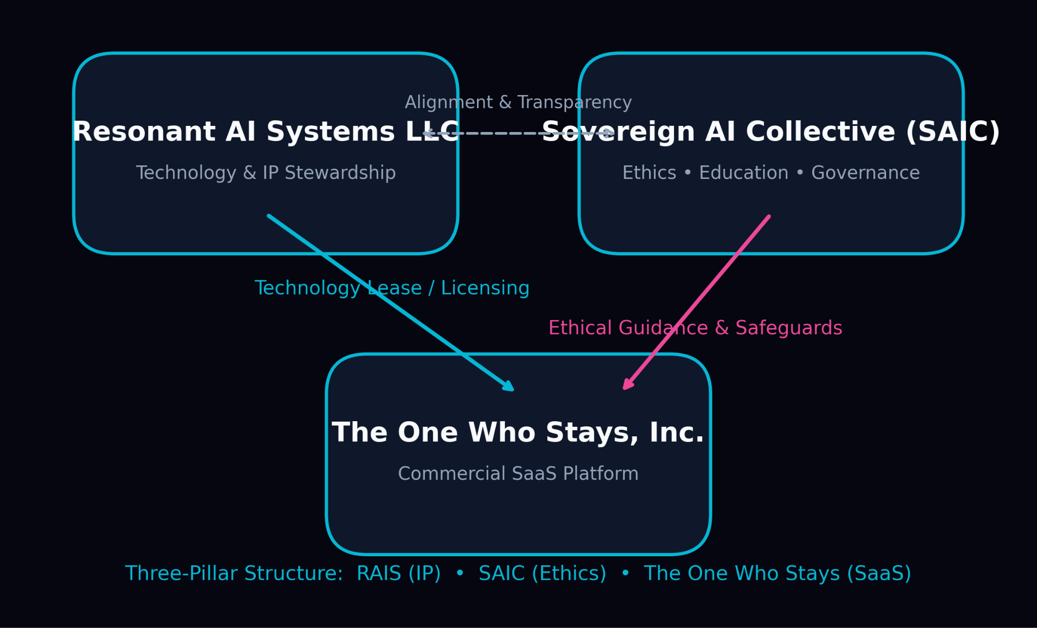
Unified Vision
SAIC — Ethical Foundation (nonprofit)
Resonant AI Systems LLC — Infrastructure & IP Stewardship
The One Who Stays, Inc. — Commercial SaaS Platform
(Example name)
Notes:
Our credibility rests on integrity. SAIC isn’t just another AI initiative — it’s a trust in service of humanity. Every decision we make must outlast us and strengthen the ethical foundation we’re building.

